Slide 1

POLYTRAUMA: A Comprehensive Review from Pathophysiology to Contemporary Management
dr. Aslambotilangih
PPDS Orthopaedi dan Traumatologi

Slide 2
Outline
A. Introduction & Epidemiology
B. Definition of Polytrauma (Old vs New/Berlin)
C. Injury Severity Scoring (AIS, ISS, NISS)
D. Pathophysiology (SIRS, CARS, MODS, TIC)
E. Clinical Grading (Pape's Classification)
F. Initial Assessment & Resuscitation (ATLS)
G. Surgical Strategy: ETC, DCO, EAC, SDS, PRISM
H. Recent Advances (2023–2024)
I. Conclusion & Take-Home Messages
Notes:
x

Slide 3
Epidemiology
Leading causes: road traffic accidents and falls from height
Upper-extremity injuries: ~21.8% of patients
Lower-extremity injuries: ~19%
Both upper and lower extremity involved: ~17.7%
Most common upper-limb fracture: clavicle (10.4%) > radius (9.9%) > humerus (7.4%)
Most common lower-limb fracture: femur (16.5%) > tibia (12.6%) > foot/ankle (5.8%)
Banerjee et al.

Slide 4
Epidemiology: Missed Injuries
Missed-injury rate in critically injured patients: 45–81%
Most missed injuries are musculoskeletal
Up to 20% of missed orthopedic injuries require surgical fixation
Key message: systematic secondary/tertiary survey is essential
Banerjee et al.

Slide 5
Definition of Polytrauma: Historical Perspective
Author (Year) | Definition Criteria
Tscherne H, 1966 | ≥2 severe injuries in head, chest, or abdomen, with ≥1 extremity injury
Border et al., 1975 | Any patient with ≥2 significant injuries
Oestern et al., 1997 | ≥2 injuries, ≥1 potentially life-threatening
Berlin Definition (2014):
AIS ≥3 in ≥2 different body regions, PLUS ≥1 of:
Systolic BP ≤90 mmHg
GCS ≤8
Base excess ≤-6.0
INR ≥1.4 (or PTT ≥40s)
Age ≥70 years
Alternative definition:
ISS ≥16 + systemic inflammatory sequelae → risk of remote organ dysfunction
Tscherne 1966; Border 1975; Oestern 1997, Pape HC, et al. J Trauma Acute Care Surg. 2014

Slide 6
Abbreviated Injury Scale (AIS)
Gennarelli TA. Abbreviated Injury Scale. AAAM, 1985
AIS Code by Injury Severity
Anatomically-based, consensus-derived severity scale
Grades each injury per body region on a six-point scale
1 = Minor → 6 = Unsurvivable
Forms the foundation of ISS/NISS calculation
AIS Code | Injury
1 | Minor
2 | Moderate
3 | Serious
4 | Severe
5 | Critical
6 | Unsurvivable / Maximum
AIS Code by Body Region
AIS Code | Region
1 | Head
2 | Face
3 | Neck
4 | Thorax
5 | Abdomen
6 | Spine
7 | Upper extremity
8 | Lower extremity
9 | Unspecified
An ISS is then calculated according to
ISS = A² + B²+ C²
A, B, C are the AIS scores of the three most injured body regions.

Slide 7
Injury Severity Score (ISS)
Baker SP et al.
ISS
3 – 8 Minor
9 – 15 Moderate
16 – 24 Serious
24 – 29 Severe
50 – 74 Critical
75 Maximum
Formula: ISS = A² + B² + C²
A, B, C = AIS scores of the three most severely injured body regions
Range: 3 (minor) to 75 (maximum)
ISS ≥16 = "serious" — clinical threshold for polytrauma
Region | Injury Description | AIS | Square Top Three
Head & Neck | Subdural Hematoma | 3 | 9
Face | No Injury | 0
Chest | Flail Chest | 4 | 16
Abdomen | Minor Contusion of Liver Complex Rupture Spleen | 5 | 25
Extremity | Fractured femur | 3
External | No Injury | 0
Injury Severity Score (ISS) |  |  | 50

Slide 8
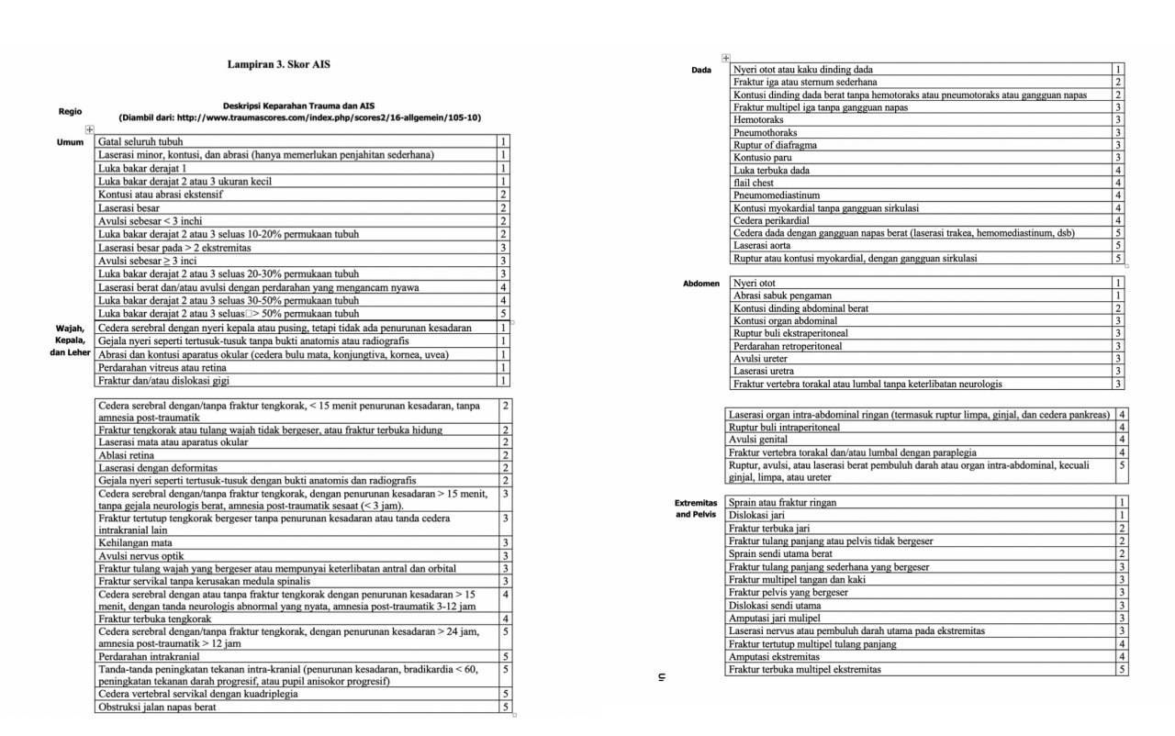

Slide 9
New Injury Severity Score (NISS)
Sums squares of 3 highest AIS scores, regardless of body region
Captures multiple severe injuries in one region (unlike ISS)
Example:
ISS = 4²+3²+2² = 29
NISS = 4²+4²+3² = 41
Key message: NISS may better reflect true cumulative injury burden
AIS Score Region
1
2
3
4
4
External
Face
Head/Neck
Abdomen
Abdomen
Galvagno S, Massey M, Bouzat P, et al. Correlation between the Revised Trauma Score and Injury Severity score: implications for prehospital trauma triage. Prehosp Emerg Care. 2019;23(2):263-70.

Slide 10
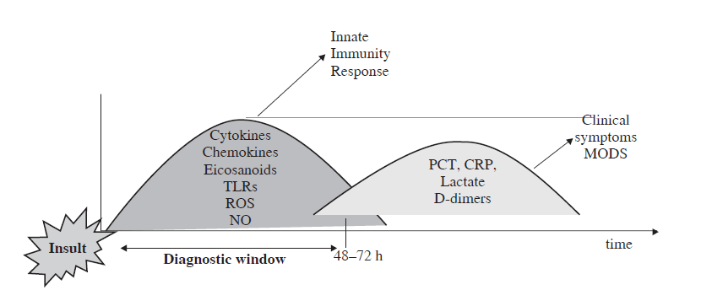
Pathophysiology
Tissue injury + hypoxia → release of inflammatory mediators & cytokines
Triggers neuroendocrine, neuroimmunological, metabolic responses
Unregulated cascade: SIRS → MODS
Tosounidis T, Giannoudis PV. Springer, 2016

Slide 11
SIRS and CARS Balance
Tosounidis & Giannoudis, 2016; Keel M, Trentz O. Injury. 2005
Trauma activates both SIRS and its counterpart CARS
Excessive SIRS → ARDS, MODS, or death
Overwhelming CARS → immunosuppression, early sepsis
Key message: delicate physiological balance requiring close monitoring
Clinical parameters of systemic inflammatory response syndrome (SIRS)
No. | Parameter
1. | Heart rate > 90/min
2. | Breathing rate > 20/min, respectively, hyperventilation with decrease of the arterial CO2 partial pressure (PaCO2) under 32 mmHg
3. | Temperature > 38 8C or < 36 8C
4. | Number of leukocytes > 12,000/mm³ or < 4000/mm³ or ! 10% juvenile neutrophil granulocytes
Diagnosis: ≥2 criteria required
Sepsis = SIRS + confirmed/suspected infection

Slide 12
Initial Response to Trauma
Local tissue destruction + organ injury + acidosis + hypoxia + pain
→ local & systemic compensatory response
Goal:
control hemorrhage, preserve vital organ perfusion
Initial phase interventions:
strictly limited to life-saving maneuvers (ATLS)
ATLS 10th Edition, ACS-COT

Slide 13
Endpoints of Resuscitation
Stable hemodynamics
No hypoxemia, no hypercapnia
Lactate <2 mmol/L
Normal coagulation
Normothermia
Urine output >1 mL/kg/hour
No vasopressor/inotropic support needed
Pape HC et al. Injury. 2019

Slide 14
Trauma-Induced Coagulopathy (TIC)
TIC is a major driver of adverse outcomes post-trauma
Mechanisms:
  Disrupted thrombin-thrombomodulin-protein C signaling
  Platelet & fibrinolytic dysfunction
  Endothelial injury from systemic inflammation
  Complement activation
Hemodilution (aggressive crystalloids) worsens coagulopathy
Combined with hypothermia + acidosis = "Triad of Death" → potentially lethal
Tosounidis & Giannoudis, 2016

Slide 15
Inflammatory Response and Alarmins
Activation of inflammatory cells
Polymorphonuclear leukocytes (PMNL), monocytes, lymphocytes, natural killer (NK) cells, and parenchymal cells become strongly activated, leading to widespread endothelial dysfunction in almost all vital organs and promoting the development of systemic inflammatory response syndrome (SIRS).
Local mediators and tissue edema
From damaged endothelial membranes, prostaglandins and thromboxanes are released, while interstitial mast cells produce histamine, bradykinin, and kallidin. These locally generated mediators increase capillary permeability and cause pronounced local tissue edema.
Alarmins, DAMPs, and aseptic SIRS/MODS
Alarmins act as potent chemoattractants and activators of antigen-presenting cells (APCs). They belong to damage-associated molecular patterns (DAMPs), such as antibacterial peptides, S100 proteins, heat-shock proteins, and high-mobility group box 1 (HMGB1). These molecules play a central role in driving “aseptic” SIRS and may ultimately lead to multiple organ dysfunction syndrome (MODS).
Tosounidis & Giannoudis, 2016

Slide 16
Key Cytokines in Polytrauma
Major cytokines in polytrauma
Interleukin-1 (IL-1), IL-6, IL-8, IL-10, and tumor necrosis factor (TNF) are key cytokines that mediate cell-to-cell communication and play a major role in the development of SIRS and MODS.
Role of TNF
TNF activates immune cells such as natural killer (NK) cells and macrophages, and can also induce apoptosis. In addition, TNF stimulates the production of thromboxane A2, prostaglandins, selectins, platelet-activating factor, and intracellular adhesion molecules, thereby amplifying the inflammatory response.
Role of IL-1
Interleukin-1 (IL-1) promotes activation of T cells and macrophages and initiates an inflammatory cascade that results in transcription of multiple pro-inflammatory cytokines.
Role of IL-6
Interleukin-6 (IL-6) becomes detectable early after major trauma. It regulates the growth and differentiation of lymphocytes and enhances activation of NK cells and neutrophils.
Tosounidis & Giannoudis, 2016

Slide 17
Clinical Course and Appropriate Actions

Slide 18
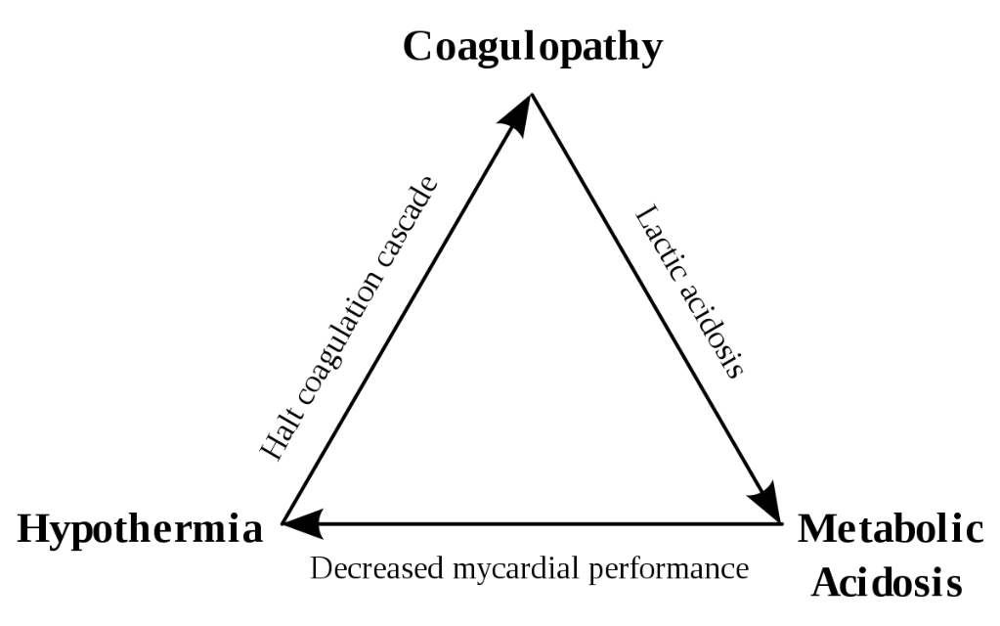
Triad of Death

Slide 19
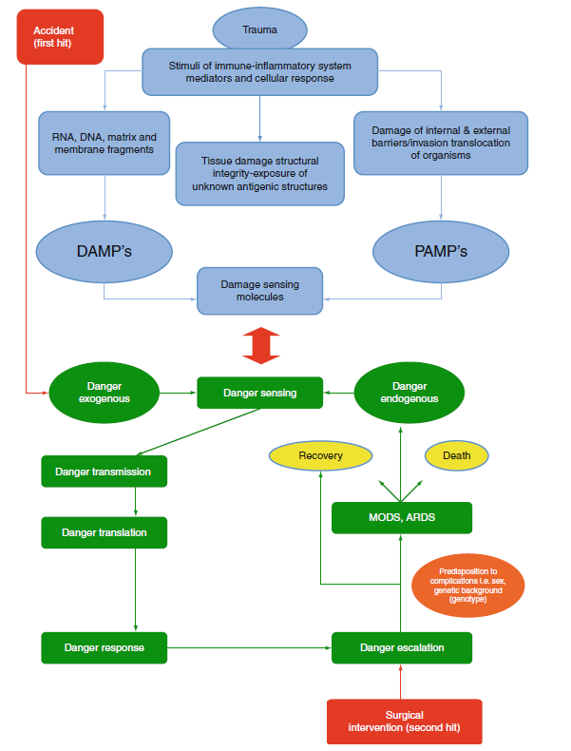
First Hit vs Second Hit Concept
First hit = initial injury → primes immune-inflammatory system
Second hit = subsequent surgery/physiologic insult → may exaggerate inflammatory response
Risk: remote organ damage, especially ARDS
Rationale for staged, damage-control strategies in unstable patients

Slide 20
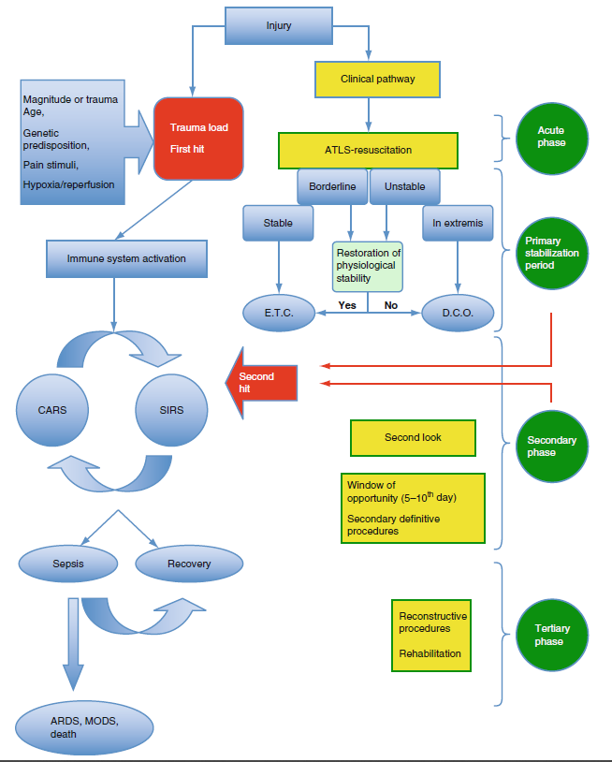
Phases of Clinical Course
Acute phase
During the acute phase, management focuses exclusively on resuscitation and life‑saving procedures.
Primary stabilization period
After initial resuscitation, during the primary stabilization period, major extremity fractures, arterial injuries, and compartment syndromes are treated using damage control orthopaedics (DCO).
Secondary period – “window of opportunity”
In the secondary period, the patient is continuously reassessed, and appropriate interventions are planned. Between days 5–10, the so‑called “window of opportunity” allows definitive fracture fixation to be safely performed.
Tertiary period – reconstruction phase
Beyond this phase, complex reconstructive procedures can be scheduled and executed according to the patient’s clinical condition and overall recovery.

Slide 21




Pape's Four Clinical Grades
Stable
Borderline
Unstable
In extremis
Nicola R. Early Total Care versus Damage Control: Current Concepts in the Orthopedic Care of Polytrauma Patients. 2013;2013:329452.

Slide 22
Clinical Grading Parameters
 | Parameter | Stable (grade I) | Borderline (grade II) | Unstable (grade III) | In extremis (grade IV)
Shock | BP (mmHg) | ≥100 | 80–100 | 60–90 | <50–60
 | Blood units (2 h) | 0–2 | 2–8 | 5–15 | >15
 | Lactate levels | Normal range | Approx 2.5 | >2.5 | Severe acidosis
 | Base deficit (mmol/L) | Normal range | No data | No data | >6–18
 | ATLS classification | I | II–III | III–IV | IV
 | UO (mL/h) | >150 | 50–150 | — | —
Coagulation | Platelet count ("g/mL) | >110000 | 90000–110000 | <70000–90000 | <70000
 | Factor II and V (%) | 90–100 | 70–80 | 50–70 | <50
 | Fibrinogen (g/dL) | >1 | Approx 1 | <1 | DIC
 | D-Dimer | Normal range | Abnormal | Abnormal | DIC
Temperature |  | >35°C | 33–35°C | 30–32°C | 30°C or less
Soft tissue injuries | Lung function, PaO2/FiO2 | >350 | 300 | 200–300 | <200
 | Chest trauma scores, AIS | AIS I or II | AIS ≥2 | AIS ≥2 | AIS ≥3
 | TSS | O | I–II | II–III | IV
 | Abdominal trauma (moore) | ≤II | ≤III | III | ≥III
 | Pelvic trauma (AO classification) | A | B or C | C | C (crush, rollover with abd trauma)
 | Extremities | AIS I or II | AIS II–III | AIS III–IV | Crush, rollover extremities
Abbreviations: BP: blood pressure, ATLS: advanced trauma life support, UO: urine output, TTS: thoracic trauma score, AIS: abbreviated injury scale, DIC: disseminated intravascular coagulation.
Nicola R. Early Total Care versus Damage Control: Current Concepts in the Orthopedic Care of Polytrauma Patients. 2013;2013:329452.

Slide 23
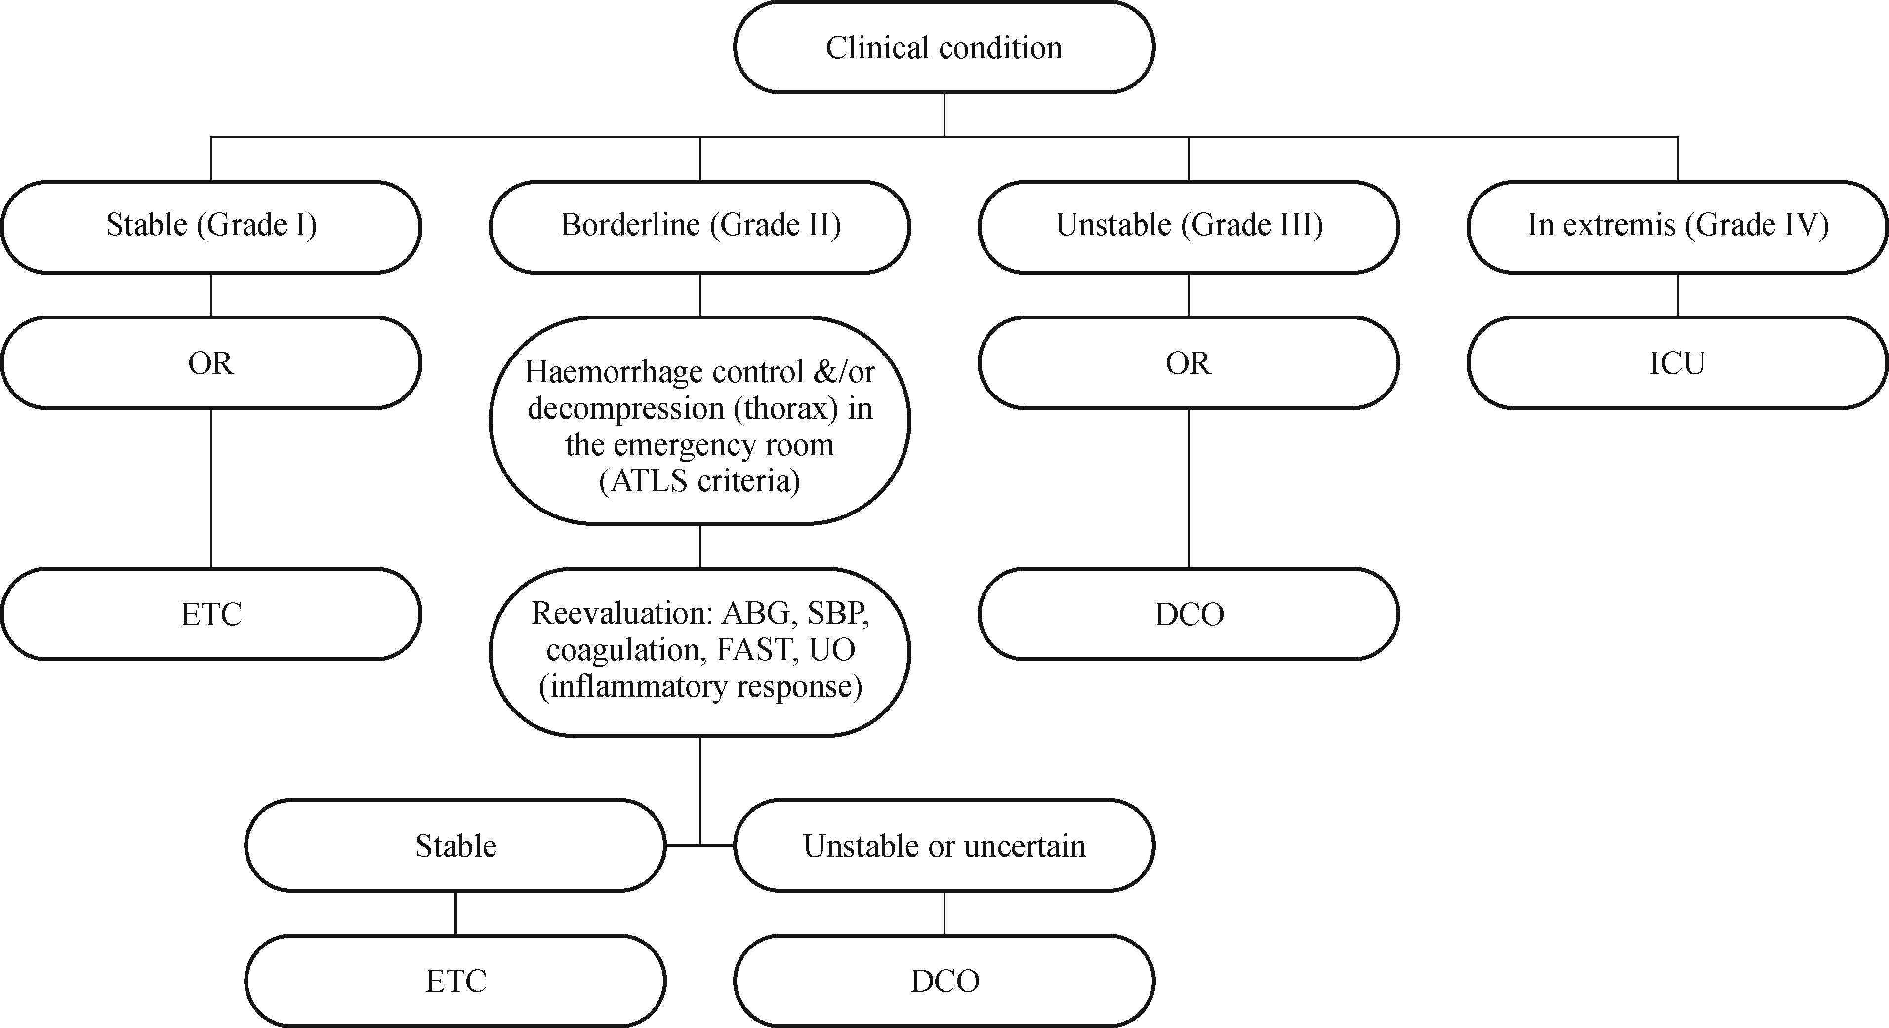
Treatment Algorithm
Fig. 1 Treatment protocol for major fractures in polytrauma (Adapted with permission from Pape et al. [13]).
ABG, arterial blood gas; SBP, systolic blood pressure; FAST, focused assessment with sonography in trauma; UO, urine output.
Halvorson JJ, Pilson HT, Carroll EA, Li ZJ. Orthopaedic management in the polytrauma patient. Front Med. 2012;6(3):234-42.

Slide 24
Philosophy of Management (ATLS)
‘TREAT LETHAL INJURY FIRST, THEN REASSESS AND TREAT AGAIN’
Sequential steps:
Primary survey
Resuscitation
Secondary survey
Definitive care

Slide 25
Early Total Care (ETC)
Foundations of Early Total Care (ETC)
Bone later published the first prospective randomized controlled trial, which established the scientific foundation for the concept of Early Total Care (ETC).
Benefit of early definitive fixation
In this study, patients who received definitive femoral fracture stabilisation within 24 hours had lower rates of fat embolism, ARDS, and sepsis‑related mortality.
Risk of delayed stabilisation
When stabilisation was delayed beyond 24 hours, the risk of developing adult respiratory distress syndrome (ARDS) increased fivefold.
Clinical implication
Consequently, the prevailing argument became that “patients are too sick not to be operated on”, emphasizing the importance of early definitive fixation in appropriately selected trauma patients.
Limitations of ETC & Emergence of DCO
ETC may worsen outcomes in most severely injured / concomitant chest-head trauma patients
Findings from Hannover trauma center
Paved the way for Damage Control Orthopaedics (DCO)

Slide 26
Damage Control Orthopaedics (DCO)
Phase I
acute life-saving procedures
Phase II
hemorrhage control + temporary fracture stabilization (e.g., ex-fix)
Phase III
ICU resuscitation
Phase IV
conversion to definitive fixation (Day 5–10, max 15 days)
Scalea et al. first described the application of DCO in a case series of 43 patients (median ISS-27) with femoral fractures. These patients underwent temporary external fixation for a median of 4 days before staged nailing occurred
Kalinterakis G, Koutras A, Syllaios A, Michalakeas, Lytras D, Tsilikis I. The evolution and impat of the “damage control orthopedics” paradigm in combat surgery: a review. EJOST. 2019;29:501-8.

Slide 27
Early Appropriate Care (EAC)
Table Early Appropriate Care protocol
Proposed by Vallier's grou
Clears patients for definitive fixation once biochemical thresholds are metp
Definitive fixation recommended once patient responds to resuscitation + ≥1 threshold met
 | Timing of fracture fixation
Parameter* | ≤36 hours | >36 hours
pH | ≥7.25 | <7.25
Base excess (mmol/L) | ≥-5.5 | <-5.5
Lactate (mmol/L) | <4.0 | ≥4.0

Slide 28
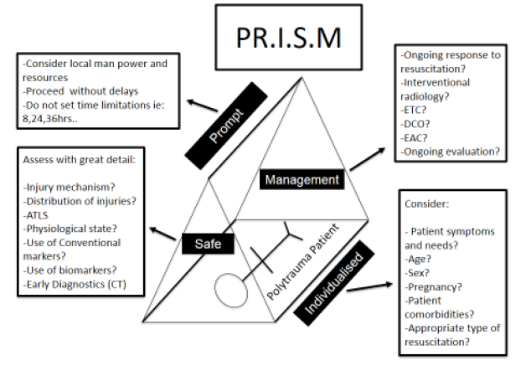
PRISM Concept
Prompt — no arbitrary time limits
Individualised — age, comorbidities, pregnancy considered
Safe — continuous reassessment of response
Management — integrate ETC/DCO/EAC as indicated
Key message: shift from rigid time-based protocols → dynamic, physiology-guided decisions
PRISM= Prompt - Individualised - Safe – Management. ATLS: Advanced Trauma life support. CT: Computed tomography. ETC: Early total care. DCO: Damage control orthopaedics. EAC: Early appropriate care

Slide 29
Safe Definitive Surgery (SDS): The 2024 Paradigm
Category | Parameter | Borderline | Unstable
Hemorrhage | SBP (mmHg) | < 100 | < 90
 | Lactate (mmol/L) | >2 | >4
 | Hemoglobin (g/dl) | < 9 | < 7
 | PBRC (on first day) | >2 | >8
Hypothermia | Body temperature (°C) | < 35 | < 33
Coagulopathy | INR | >1.2 | >1.5
ROTEM | Extem CT (s) | >60 | >80
 | Extem MCF (mm) | < 60 | < 45
 | Fibtem MCF (mm) | < 12 | < 5
TEG | ACT (s) | >110 | >128
 | MA (mm) | < 60 | < 55
 | LY30 (%) | >3 | >5
Tissue injury
Brain | ICP (mmHg) | >15 | >20
 | CPP (mmHg) | < 70 | < 60
 | Midline shift (mm) | >5 | ≥5
Chest | TTSS | >6 | >7
Abdomen | Moore classification | >2 | >3
Newest evolution: "Safe Definitive Surgery" (Kalbas, Pape et al., 2024)
Moves away from fixed 24-hour rule
Uses serial, multi-parameter reassessment: hemorrhage markers, coagulation, hypothermia, tissue injury severity
Definitive fixation typically achievable within 24h if no ongoing shock
Kalbas Y, Heining SM, Kaiser A, et al. Front Med. 2024

Slide 30
2023–2024 International Consensus on Fracture Timing
2023 Delphi panel (Univ. Hospital Zurich) — general surgery, trauma, ortho, neurosurgery
Reviewed 74 publications
Reached ≥75% agreement on 20 consensus statements
Published in J Trauma Acute Care Surg (2024)
Current international benchmark for fracture-timing in complex polytrauma with concomitant injuries
ESTES Consensus; J Trauma Acute Care Surg. 2024 Aug

Slide 31
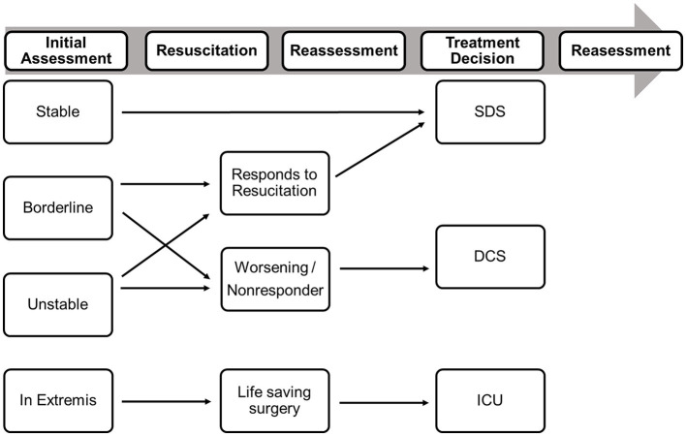
Surgical Priority Hierarchy (Updated Concept)
1. Life-saving
airway, thoracostomy, hemorrhage control
2. CNS-saving
severe TBI, spinal cord decompression
3. Limb-saving
vascular repair, compartment release, mangled extremity
4. Function-preserving
open fracture debridement, dislocation reduction
Decision-making in Polytrauma patients should be based on the initial assessment of the patient physiology and on the response to resuscitative measures. DCS, damage control surgery; ICU, intensive care unit [modified from Pape et al.].
Cumulative operative time capped ~6 hours to limit additional "surgical load"
Kalbas Y, et al. Front Med. 2024

Slide 32
Conclusion
Polytrauma is a dynamic systemic condition, not merely the presence of multiple fractures, because injury severity, physiological derangement, inflammatory response, and timing of intervention all determine patient outcome.
Early management must prioritize survival, with strict adherence to ATLS principles, prompt resuscitation, hemorrhage control, and recognition of life-threatening complications such as coagulopathy, hypothermia, acidosis, SIRS, and MODS.
Definitive fracture fixation should be physiology-driven, not based on a rigid time rule alone; in stable patients, fractures should be stabilized as early as safely possible according to the patient’s overall physiological status.
The modern management strategy has shifted from universal Early Total Care (ETC) toward a more individualized staged approach, integrating ETC, Damage Control Orthopaedics (DCO), Early Appropriate Care (EAC), PRISM, and most recently Safe Definitive Surgery (SDS).
Damage Control Orthopaedics should be reserved for patients at risk, particularly those who are borderline, unstable, or in extremis, in order to minimize the harmful “second hit” and prevent further physiological deterioration.
Overall, the current goal in polytrauma care is to deliver timely, individualized, and safe fracture management, balancing the benefits of early fixation with the need to protect patients from avoidable systemic complications.

Slide 33
Reference
Moore TA, Simske NM, Vallier HA. Fracture fixation in the polytrauma patient: Markers that matter. Injury [Internet]. 2020;51:S10–4. Available from: https://doi.org/10.1016/j.injury.2019.12.024
Berwin JT, Pearce O, Harries L, Kelly M. Managing polytrauma patients. Injury. 2020;51(10):2091–6.
Devendra A, Nishith PG, Dilip Chand Raja S, Dheenadhayalan J, Rajasekaran S. Current updates in management of extremity injuries in polytrauma. J Clin Orthop Trauma [Internet]. 2020. Available from: https://doi.org/10.1016/j.jcot.2020.09.031
Pape HC, Lefering R, Butcher N, Peitzman A, Leenen L, Marzi I, et al. The definition of polytrauma revisited: An international consensus process and proposal of the new “Berlin definition.” J Trauma Acute Care Surg. 2014;77(5):780–6.
Tosounidis T, Giannoudis PV. Pathophysiology of Polytrauma. In: Pape HC, Sanders R, Borrelli J Jr, editors. The Poly-Traumatized Patient with Fractures. Berlin, Heidelberg: Springer; 2016. Available from: https://doi.org/10.1007/978-3-662-47212-5_5
Upadhyaya GK, Iyengar KP, Jain VK, Vaishya R. Evolving concepts and strategies in the management of polytrauma patients. J Clin Orthop Trauma. 2020;11(Suppl 1):S4–8. PMCID: PMC7920163. Available from: https://pmc.ncbi.nlm.nih.gov/articles/PMC7920163/
Kalbas Y, Heining SM, Kaiser A, Klingebiel T, Pfeifer R, Wanner GA, Pape HC. Fracture fixation in polytraumatized patients—From an interdisciplinary early total/appropriate care to the safe definitive surgery concept. Front Med (Lausanne). 2024;11:1362986. PMCID: PMC11069308. Available from: https://pmc.ncbi.nlm.nih.gov/articles/PMC11069308/

